Slide 1
AWS - Introduction

Slide 2
What is Cloud Computing?
Practice of using a network of remote servers hosted on the Internet to store, manage, and process data, rather than a local server or a personal computer.
Companies offering such kinds of cloud computing services are called cloud providers.
They typically charge for cloud computing services based on usage.
Some of the cloud providers are
Amazon Web Services (AWS)
Microsoft Azure
Google Cloud (GCP—formerly Google Cloud Platform)
IBM Cloud (formerly SoftLayer)
Oracle Cloud

Slide 3
Types of Cloud Computing
Most cloud computing services fall into five broad categories:
Software as a service (SaaS)
Instead of installing and maintaining software, we simply access softwares via the Internet.
We free ourselves from the complex software and hardware management.
Platform as a service (PaaS)
The development and deployment of the application take place independent of the hardware.
The consumer does not manage or control the underlying cloud infrastructure including network, servers, operating systems, or storage.
Has control over the deployed applications and possibly configuration settings for the application-hosting environment.
Infrastructure as a service (IaaS)
It simply provides the underlying operating systems, security, networking, and servers for developing such applications, and services, and deploying development tools, databases, etc.
Anything/Everything as a service (XaaS)
Most of the cloud service providers nowadays offer anything as a service.
It is a compilation of all of the above services including some additional services.
Function as a Service (FaaS)
FaaS is an event-driven execution model.
It is implemented in the serverless container.

Slide 4
Cloud deployment models
Public cloud
Deliver resources, such as compute, storage, network, develop-and-deploy environments, and applications over the internet.
They are owned and run by third-party cloud service providers like Google Cloud.
Private cloud
Private clouds are built, run, and used by a single organization, typically located on-premises.
They provide greater control, customization, and data security but come with similar costs and resource limitations associated with traditional IT environments.
Hybrid cloud
Environments that mix at least one private computing environment (traditional IT infrastructure or private cloud, including edge) with one or more public clouds are called hybrid clouds.
They allow you to leverage the resources and services from different computing environments and choose which is the most optimal for the workloads.

Slide 5
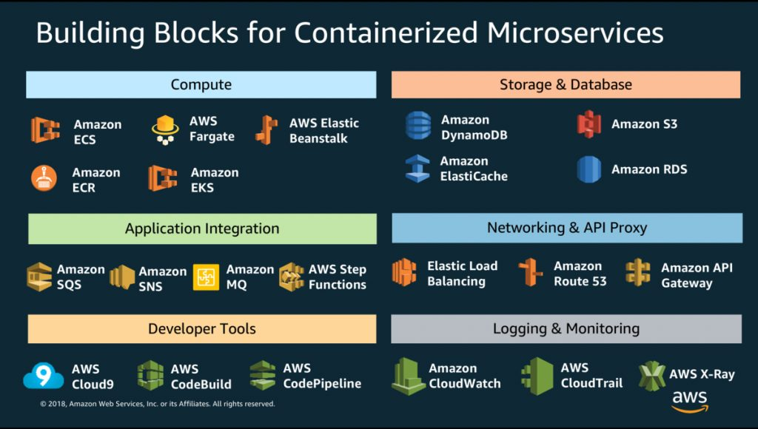
AWS services for containerizing microservices

Slide 6
AWS Services
Amazon Elastic Container Service(ECS) and Amazon Elastic Kubernetes Service(EKS):
Container orchestration engines that can be used to deploy, manage, and scale containerized applications
AWS Fargate and Elastic Compute Cloud(EC2):
Hosting options for microservices
AWS Lambda:
A serverless way to build microservices
AWS CodeBuild:
A fully managed build service that can compile source code, run unit tests, and produce artifacts for deployment
AWS CodeCommit:
A version control service that can be used to privately store and manage Git repositories
AWS Elastic Beanstalk:
An orchestration layer that can be used on top of existing AWS services like EC2, Auto Scaling Groups, and Load Balancers
AWS Step Functions:
A serverless workflow service that can be used to coordinate microservices and build complex applications
Amazon DynamoDB:
A NoSQL database that can be used to create tables for storing and retrieving data
Service mesh:
A software layer that can be used to manage communication between multiple microservices

Slide 7
Regions, Availability Zones, and Local Zones
Amazon cloud computing resources are hosted in multiple locations world-wide.
These locations are composed of AWS Regions, Availability Zones, and Local Zones.
Each AWS Region is a separate geographic area.
Each AWS Region has multiple, isolated locations known as Availability Zones.
By using Local Zones, you can place resources, such as compute and storage, in multiple locations closer to your users.

Slide 8
Regions, Availability Zones, and Local Zones
Amazon RDS enables you to place resources, such as DB instances, and data in multiple locations.
Resources aren't replicated across AWS Regions unless you do so specifically.
Amazon operates state-of-the-art, highly-available data centers.
Although rare, failures can occur that affect the availability of DB instances that are in the same location.
If you host all your DB instances in one location that is affected by such a failure, none of your DB instances will be available.

Slide 9
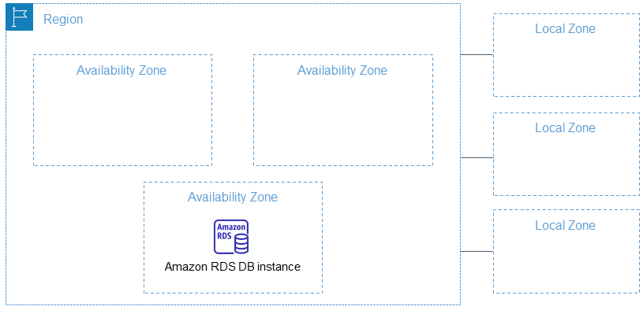
Regions, Availability Zones, and Local Zones

Slide 10
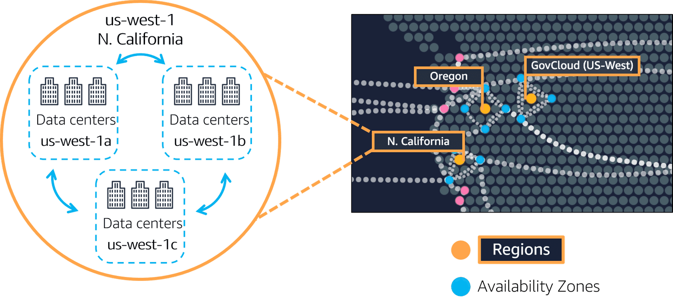
Regions, Availability Zones, and Local Zones

Slide 11
END

